Slide 1
Implementation of
K-truss Decomposition Algorithm
Name: Xingyu Yan
Director: A. Erdem Sariyuce

Slide 2
Contents
K-truss Decomposition
My Implementation
Improvements by Researchers
Next Step and Potential Improvement

Slide 3
K-truss Decomposition

Slide 4
Truss value for an edge

Slide 5
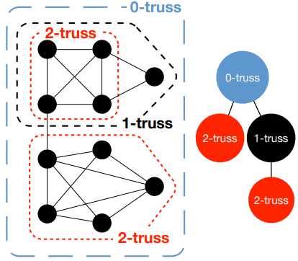
K-truss Decomposition
[Cohen, Jonathan]

Slide 6
My Current
Implementation

Slide 7
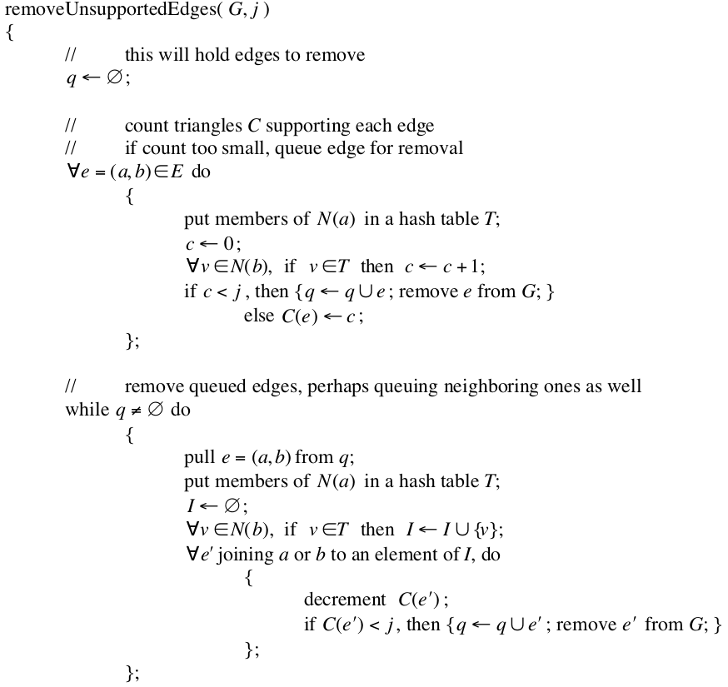
Implementation:
Based on the work of Cohen
  Early & fundamental
  Peeling algorithm
  No optimization
Pseudo Code
[Cohen, Jonathan. "Trusses: Cohesive subgraphs for social network analysis." National security agency technical report 16 (2008): 3-1.]

Slide 8
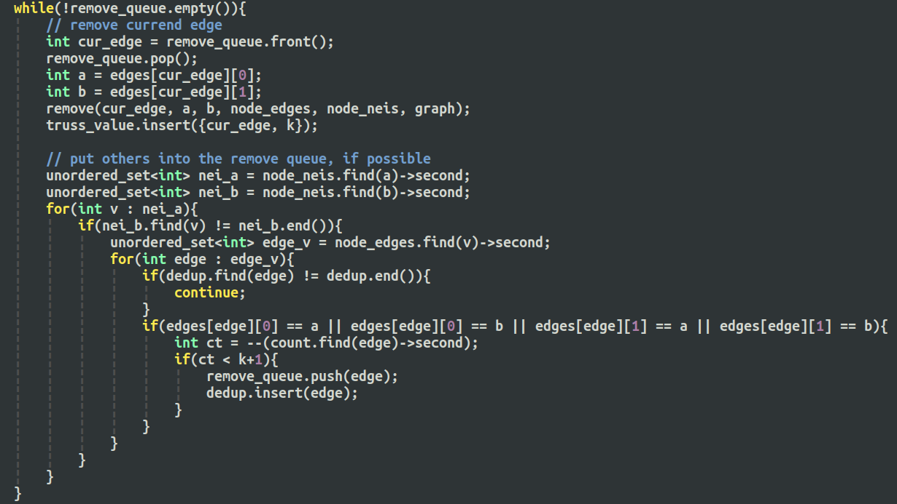
Implementation:

Slide 9
Implementation:
Checked all neighbor vertices, even they not form a triangle

Slide 10
Implementation:
Reverse search to find triangle edge, which is inefficient

Slide 11
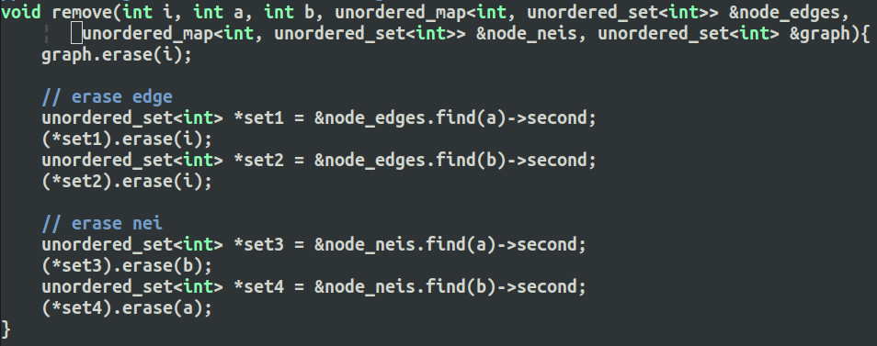
Implementation:
Explicit remove vertices, edges, neighbors…
not efficient

Slide 12
Implementation:
Reasons
  Not save the triangle information
  Each time, search & check
  set<> erase at all related place

Slide 13
Improvements from
Literature

Slide 14
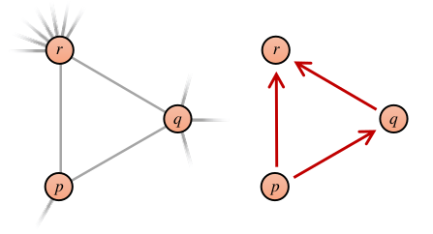
How to use the triangle information?
dp < dq < dr
TC[{u,v}]: triangle count
qrC[{q,r}]: count for closure of wedge
pRefC[q/r][p]: count for wedge edge
[Pearce, Roger, and Geoffrey Sanders. "K-truss decomposition for Scale-Free Graphs at Scale in Distributed Memory." 2018 IEEE High Performance extreme Computing Conference (HPEC). IEEE, 2018.]

Slide 15
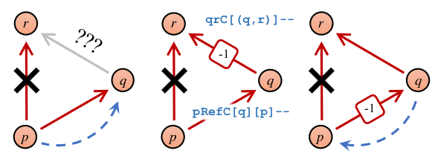
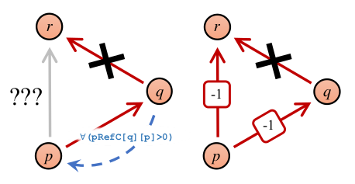
How to use the triangle information?
dp < dq < dr
TC[{u,v}]: triangle count
qrC[{q,r}]: count for closure of wedge
pRefC[q/r][p]: count for wedge edge
[Pearce, Roger, and Geoffrey Sanders. "K-truss decomposition for Scale-Free Graphs at Scale in Distributed Memory." 2018 IEEE High Performance extreme Computing Conference (HPEC). IEEE, 2018.]

Slide 16
Prof. Saríyüce’s Work
Ego-Facebook data:
  Node: 4,039
  Edge: 88,234
Performance:
My code: 1min49s
Prof’s code: 0.6s
[Sariyüce, Ahmet Erdem, and Ali Pinar. "Fast hierarchy construction for dense subgraphs." Proceedings of the VLDB Endowment 10.3 (2016): 97-108.]

Slide 17
Next Step

Slide 18
Next step:
  Understand the improvement by Prof. Sariyüce
  Try other methods to find set intersection (to find triangles)
    Finding triangles ==
    finding the intersection of neighbor set of two edge vertices

Slide 19
Thanks!

